Slide 1
HawkStudy
Group E - Labib Kreidi, Mansoor Syed, Neil Bhandari, Anwar Adam, Alan Palayil

Slide 2
Problem Statement
College Students need study spaces, to have a resourceful environment to study, learn, grow and collaborate with peers.
Lack of an effective online space reservation system is halting student’s academic success.
Waiting in line to find a study space increases the likelihood of contracting Covid-19 and risks the reception staff with catching the virus.
Students with busy schedules and commitments can’t afford to lose time waiting for a room, and therefore prefer a reserved space beforehand to be time efficient.

Slide 3
Customers
Students who don’t like studying in a cramped area.
Students who would like to have access to equipment like whiteboards and monitors
Students who don’t have the time to go around campus to find areas to study at.
Students who want their own privacy and who want to study individually.
Students who want to collaborate with other students to work on projects, homework, etc.

Slide 4
Personas
Kunj the researcher, 20
Kunj is a student researcher, and has a packed schedule. His roommate is social and brings his friends over to the room, and therefore Kunj uses HawkStudy to reserve campus spaces to study, research and go over notes in his free time. HawkStudy saves him time and makes his study times be more organized and efficient.
Dillon the film director, 25
Dillon is a grad student who has a small scale youtube channel. He has a team of 6 people and doesn’t have space in his dorm room and extra equipment as monitors, whiteboards, and others. Dillon uses HawkStudy to reserve big study spaces so his team can work together on the youtube channel and can plan space reservations ahead of time rather than waiting in line with an uncertainty.

Slide 5
Scenario
Kira is attending his lecture and gets an assignment which is due this weekend. He decides to check ‘HawkStudy’ to check the real time availability of the study halls on campus. ‘HawkStudy’ would tell the availability of study halls near him and open the fill-up form.
Kira can also check how many people can be in the room so he knows how many friends to invite to complete the assignment with him.

Slide 6
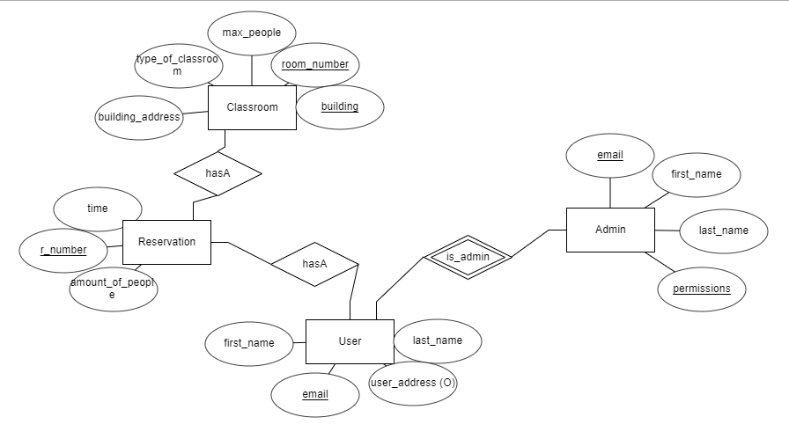
ER Diagram

Slide 7

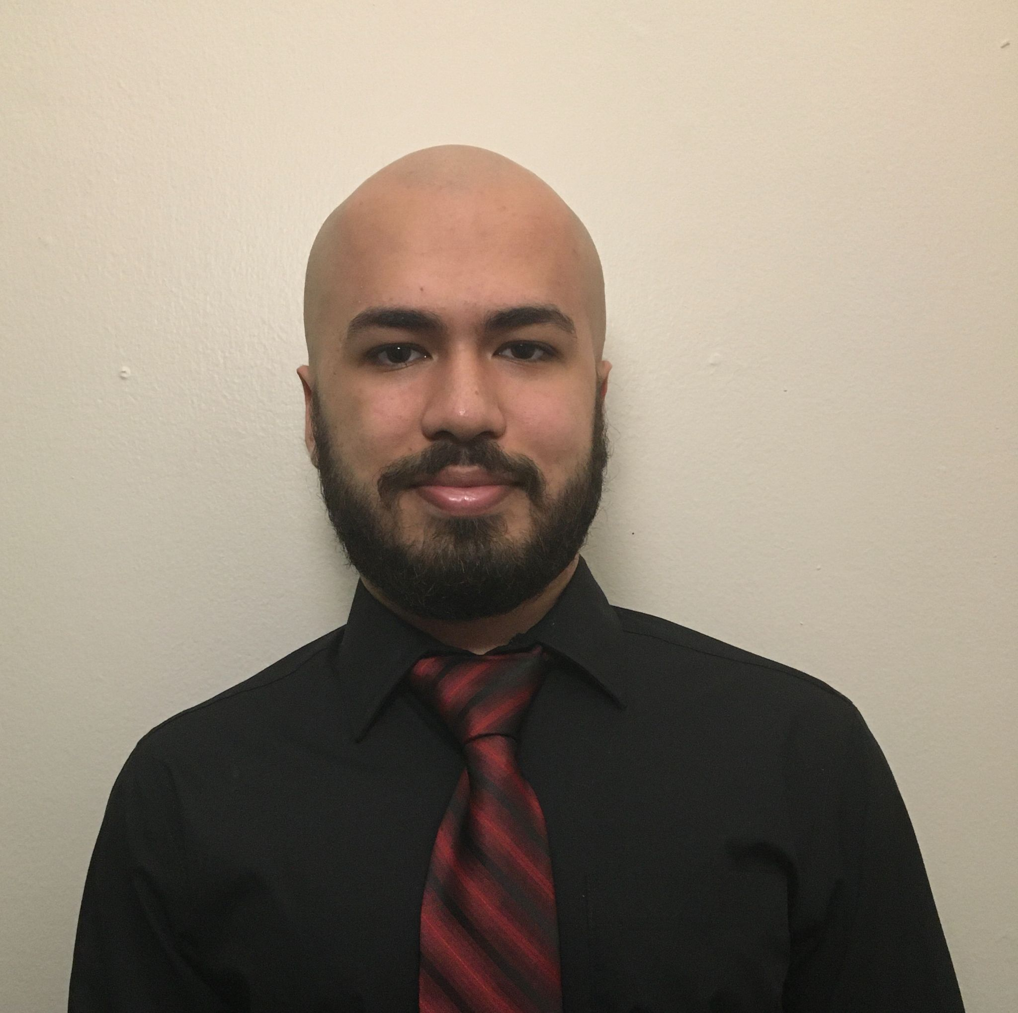



Team
Mansoor Syed
Labib Kreidi
Anwar Adam
Alan Palayil
Neil Bhandari

Slide 8
Work Distribution
Neil (Sophomore in Computer Science): Personas, Scenarios, Demographics.
Alan (Sophomore in Computer and Cybersecurity Engineering) and Anwar (Sophomore in Artificial Intelligence): Front-end GUI development and Kanban management.
Labib (Sophomore in Computer Science) and Mansoor (Sophomore in Computer Science): Full-stack development Database management, connectivity, GUI.

Slide 9
Kanban Board
Let’s go to the Kanban Board together...

Slide 10
What We Learned - Software Development
JDBC Database connection with Java, PostgreSQL, and Spring Boot
HTML references
Implementation of Bootstrap Modals
Javascript OnClick functions for interacting with database modals.

Slide 11
What We Learned - Ourselves
Importance of time management
Organization skills with kanban board
Should take things step by step instead of looking at the full picture at once

Slide 12
What would we do differently
Make a availability calendar and set someone in charge of getting everyone to get together
Set up github repository from start to prevent issues committing
Create stricter deadlines for features

Slide 13
Thanks
Group E - Labib Kreidi, Mansoor Syed, Neil Bhandari, Anwar Adam, Alan Palayil

